Slide 1
QoT Estimation in Optical Networks
Destiny Mora and Chiara Draghini

Slide 2
The Goal
Given span lengths and link occupancy, predict SNR to appropriately configure the modulation format, or classify modulation format directly.

Slide 3
The Data
MF | Min Required SNR, dB
QPSK | 8.7
8QAM | 12.8
16QAM | 15.2
32QAM | 18.2
64QAM | 21.0
Two datasets: Germany and European
Columns:
span_lengths | link_occupancy | SNR_dB

Slide 4
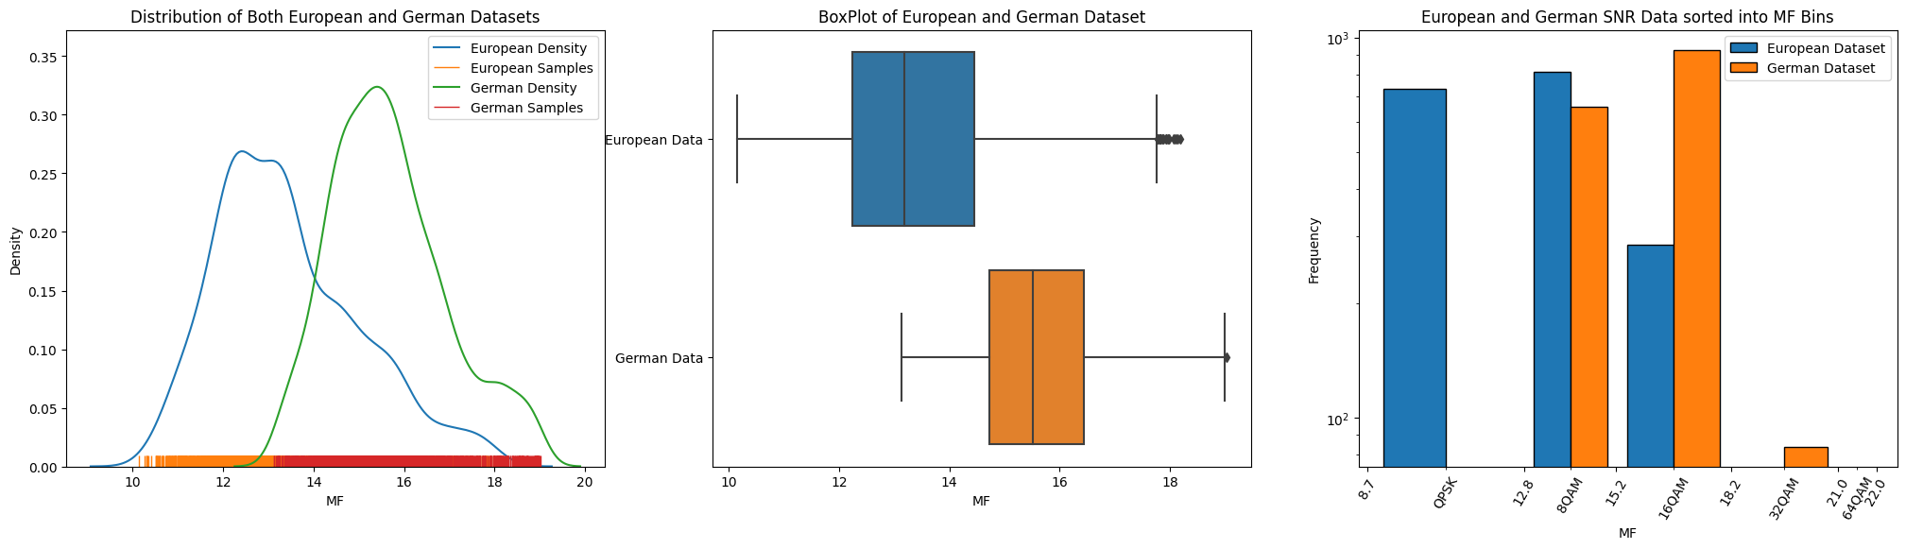
Data Distribution

Slide 5
The Method
Gradient Boosting Regressor: Predict SNR, then convert to MF
-> Loss Function: Penalize overestimations or underestimations
Gradient Boosting Classifier: Predict MF directly
Transfer Learning to leverage the two datasets

Slide 6
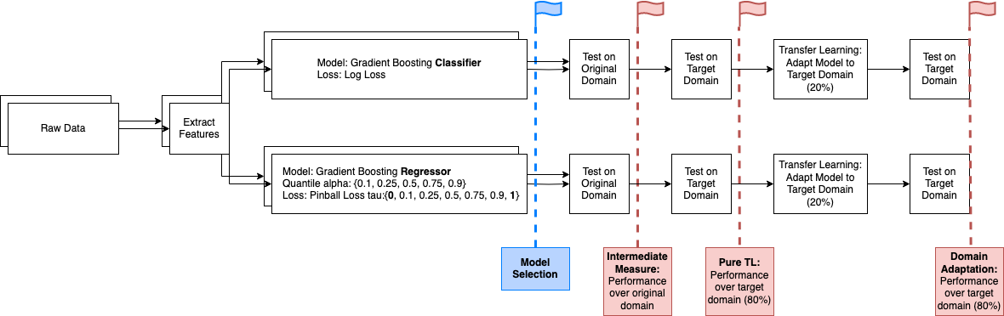
Pipelines

Slide 7
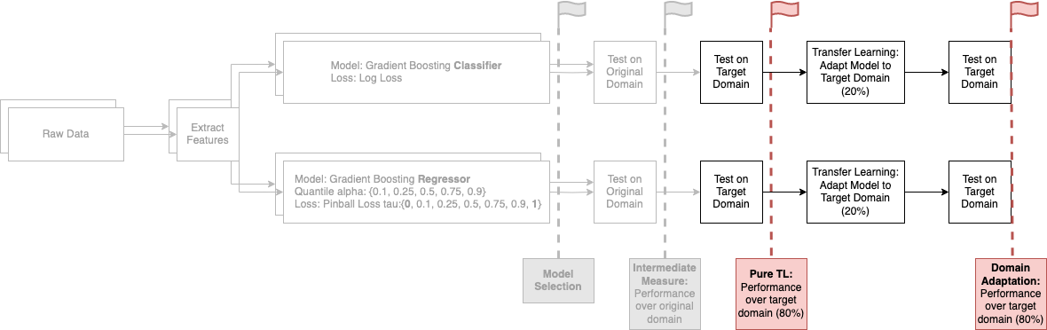
Pipelines

Slide 8
Pipelines
Hyperparameter Optimization

Slide 9
Pipelines
Hyperparameter Optimization
Model Selection

Slide 10
Pipelines
Hyperparameter Optimization
Model Selection
Compare Performance

Slide 11
Pipelines
Hyperparameter Optimization
Model Selection
Compare Performance
Compare TL Techniques

Slide 12
Quantile Regression
It is a statistical technique to estimate the relationship between:
the predictors
and
a specific quantile of the response variable
Each quantile model will be identified in the following manner:
Q_<alfa_value> PB_<tau_value>
Where:
Q_<alfa_value> specifies the quantile of the model
PB_<tau_value> indicates the pinball loss information
A quantile represents a specific percentile or portion of a distribution of data

Slide 13
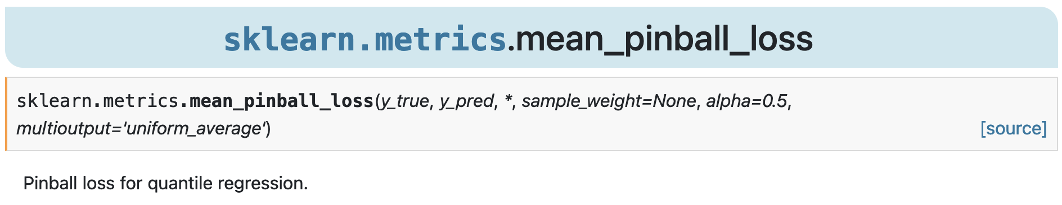
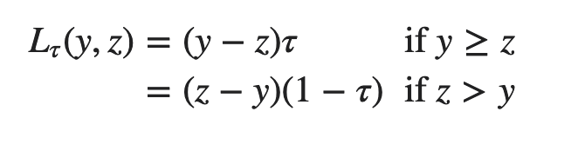
Pinball Loss
Each quantile model will be identified in the following manner:
Q_<alfa_value> PB_<tau_value>
Where:
Q_<alfa_value> specifies the quantile of the model
PB_<tau_value> indicates the pinball loss information
True
Pred
Penalize overestimations
Penalize underestimations
𝝉 = 0
𝝉 = 1

Slide 14
Hyperopt
Compare model parameters
Compare with models with default settings
Hyperparameter Optimization
150 trials
Cross validation in each trial
Only optimized once per model configuration
16 models per dataset
space = {
'learning_rate': hp.uniform('learning_rate', 0.001, 0.9),
'n_estimators' : hp.quniform('n_estimators', 50, 100, 5),
'max_depth': hp.quniform('max_depth', 2, 10, 1),
'min_samples_leaf': hp.quniform('min_samples_leaf', 3, 50, 1),
'min_samples_split': hp.quniform('min_samples_split', 5, 30, 1)
}

Slide 15
Hyperopt
Compare model parameters
Compare with models with default settings
Hyperparameter Optimization: Classifiers
Classifiers: <model>.get_params()
{'learning_rate': 0.24563060794923214,
'max_depth': 2,
'min_samples_leaf': 27,
'min_samples_split': 7,
'n_estimators': 65}
{'learning_rate': 0.1,
'max_depth': 3,
'min_samples_leaf': 1,
'min_samples_split': 2,
'n_estimators': 100}
{'learning_rate': 0.33646423098832695,
'max_depth': 3,
'min_samples_leaf': 25,
'min_samples_split': 30,
'n_estimators': 55}
Optimized GradientBoostingClassifier
(German dataset)
Default GradientBoostingClassifier
Optimized GradientBoostingClassifier
(European dataset)

Slide 16
Hyperopt
Compare model parameters
Compare with models with default settings
Hyperparameter Optimization: Regressors
90% Quantile Regressors: <model>.get_params()
{'alpha': 0.9,
'learning_rate': 0.48228580970024987,
'max_depth': 2,
'min_samples_leaf': 14,
'min_samples_split': 27,
'n_estimators': 80}
{'alpha': 0.9,
'learning_rate': 0.1,
'max_depth': 3,
'min_samples_leaf': 1,
'min_samples_split': 2,
'n_estimators': 100}
{'alpha': 0.9,
'learning_rate': 0.19454710696540278,
'max_depth': 3,
'min_samples_leaf': 13,
'min_samples_split': 9,
'n_estimators': 85}
Optimized GradientBoostingRegressor
(German dataset)
Default GradientBoostingRegressor
Optimized GradientBoostingRegressor
(European dataset)

Slide 17
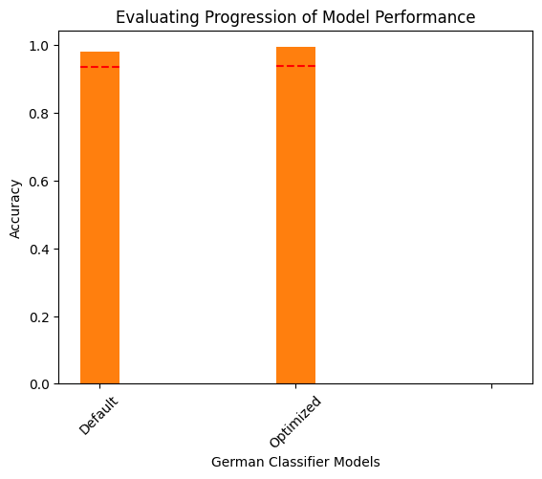
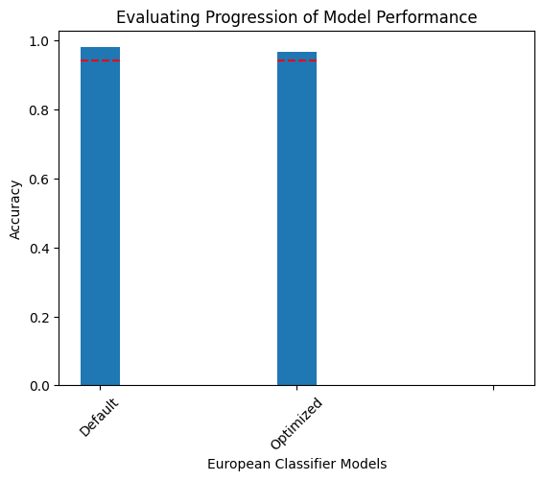
Hyperopt
Compare model parameters
Compare with models with default settings
Hyperparameter Optimization: Classifiers
----
CV Scores

Slide 18
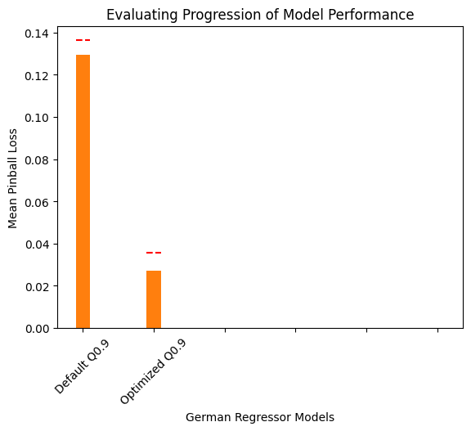
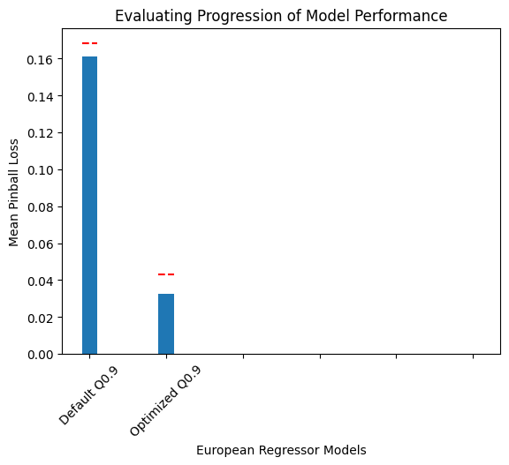
Hyperopt
Compare model parameters
Compare with models with default settings
Hyperparameter Optimization: Regressors
----
CV Scores

Slide 19
Calculating AIC and BIC scores
Evaluation over AIC and BIC scores
Calculating Allocation scores
Evaluation over Allocation scores
Quantile Selection
def aic_bic(y_true, y_pred, q, verbose=False):
residuals = y_true - y_pred
scale = np.percentile(np.abs(residuals), 100*q)
log_likelihood_est = np.log(q / scale) - q *
np.abs(residuals) / scale
n = len(y_true)
k = 5
aic = -2 * np.sum(log_likelihood_est) + 2 * k
bic = -2 * np.sum(log_likelihood_est) + np.log(n) * k
if verbose:
print(f'AIC: {aic}')
print(f'BIC: {bic}')
return aic, bic
AIC = - 2ln(L) + 2K
BIC = - 2ln(L) + Kln(n)
n: number of samples
K: number of parameters
L: log likelihood
They reward goodness of the fit assessed by the likelihood function
They include a penalty that is an increasing function of the number of estimated parameters which discourages overfitting

Slide 20
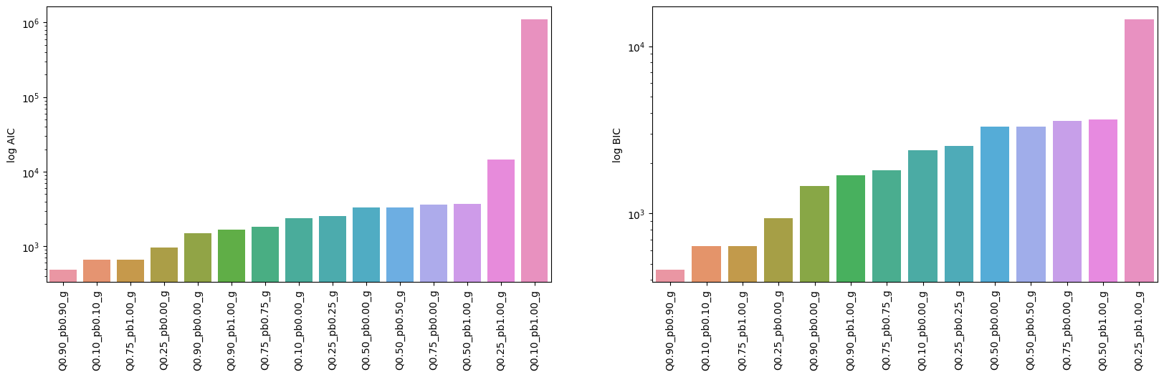
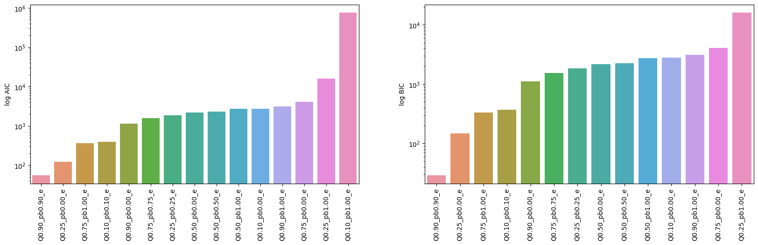
Calculating AIC and BIC scores
Evaluation over AIC and BIC scores
Calculating Allocation scores
Evaluation over Allocation scores
Quantile Selection
German Dataset
European Dataset

Slide 21
Calculating AIC and BIC scores
Evaluation over AIC and BIC scores
Calculating Allocation scores
Evaluation over Allocation scores
Quantile Selection
German Dataset
European Dataset

Slide 22
Calculating AIC and BIC scores
Evaluation over AIC and BIC scores
Calculating Allocation scores
Evaluation over Allocation scores
Quantile Selection
Assumptions: under allocations are worse than over allocations for the real case scenario, since they could potentially cause a disruption of the service.
metrics['Score'] = metrics['Correct Allocations'] + (-1 * metrics['Under Allocations'])
Considering number of correct allocations inherently excludes incorrect ones
Negative term for under allocations implies an extra penalty

Slide 23
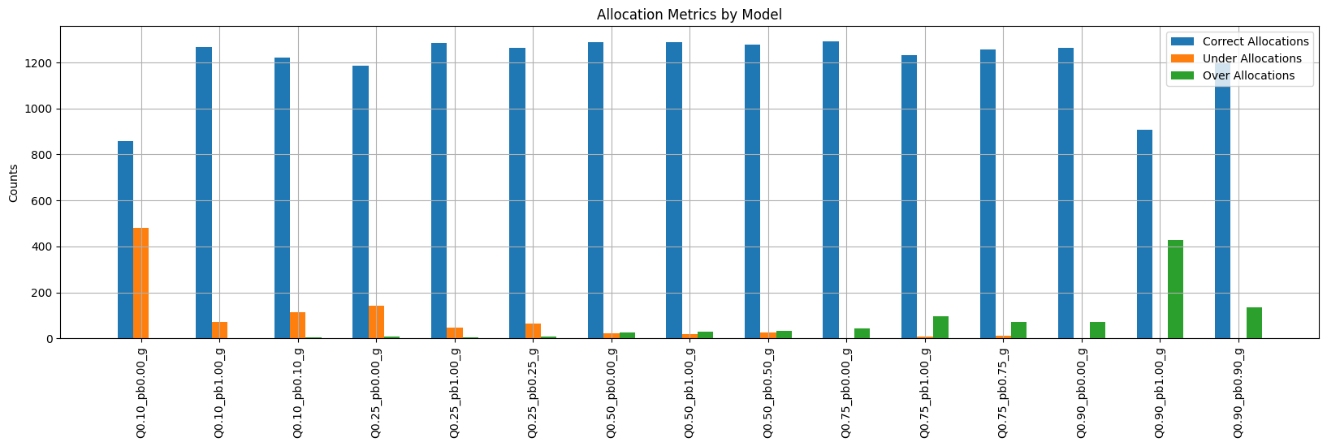
Calculating AIC and BIC scores
Evaluation over AIC and BIC scores
Calculating Allocation scores
Evaluation over Allocation scores
Quantile Selection
German Dataset

Slide 24
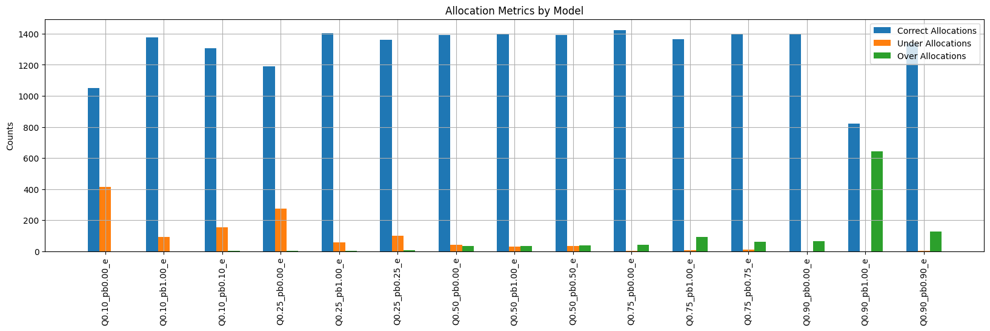
Calculating AIC and BIC scores
Evaluation over AIC and BIC scores
Calculating Allocation scores
Evaluation over Allocation scores
Quantile Selection
European Dataset

Slide 25
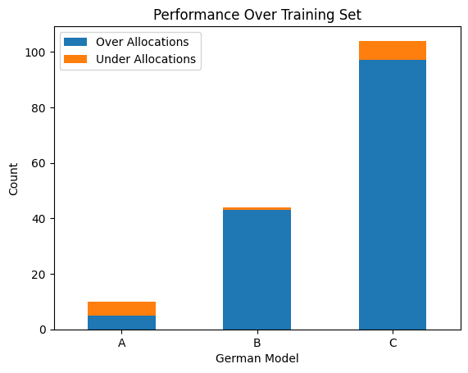
Best Models: German
Model | Cross Validation Score
A: Optimized Classifier | 0.93716
B: Best Allocation Regressor | 0.11308
C: Best AIC/BIC Regressor | 0.02760
Based on Allocation Scores:
➤ Quantile: 75%, Penalize Over (0)
Based on AIC and BIC Scores:
➤ Quantile: 75%, Penalize Under (1)

Slide 26
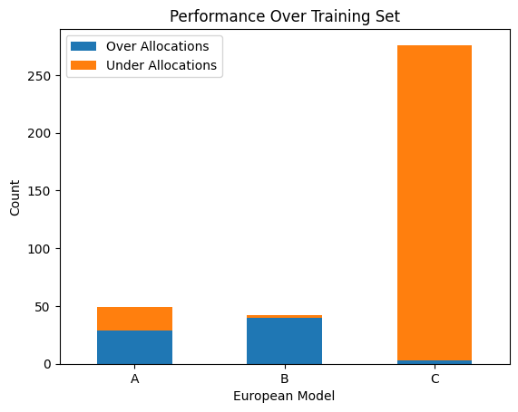
Final point
Model | Cross Validation Score
A: Optimized Classifier | 0.94061
B: Best Allocation Regressor | 0.14628
C: Best AIC/BIC Regressor | 0.03462
Best Models: European
A one-line description of it
Based on Allocation Scores:
➤ Quantile: 75%, Penalize Over (0)
Based on AIC and BIC Scores:
➤ Quantile: 25%, Penalize Over (0)

Slide 27
A: Optimized Classifier
B: Regressor chosen with Allocation scores
C: Regressor chosen with AIC and BIC scores
Testing Phase
Model | Dataset | Accuracy | Precision | Recall | F1 | Under | Over | Correct | Miss Rate
clf_opt_e | European | 0.93733 | 0.93629 | 0.93217 | 0.93417 | 11 | 12 | 344 | 0.06267
clf_opt_g | German | 0.93731 | 0.93933 | 0.93575 | 0.93737 | 8 | 13 | 314 | 0.06269

Slide 28
A: Optimized Classifier
B: Regressor chosen with Allocation scores
C: Regressor chosen with AIC and BIC scores
Testing Phase
Mean Pinball Loss
D2 Pinball Score
Model | Dataset | MSE | MAE | MPL | R2 | D2 | Under | Over | Correct | Miss Rate
Q075_pb0_e | European | 0.06946 | 0.20634 | 0.10317 | 0.96974 | 0.83129 | 10 | 18 | 339 | 0.07629
Q075_pb0_g | German | 0.05471 | 0.18008 | 0.09004 | 0.96784 | 0.82519 | 4 | 18 | 313 | 0.06567
It assesses the accuracy of a quantile forecasting model
It’s the fraction of the pinball loss explained

Slide 29
A: Optimized Classifier
B: Regressor chosen with Allocation scores
C: Regressor chosen with AIC and BIC scores
Testing Phase
Model | Dataset | MSE | MAE | MPL | R2 | D2 | Under | Over | Correct | Miss Rate
Q025_pb0_e | European | 0.24993 | 0.34960 | 0.17480 | 0.89112 | 0.71415 | 74 | 2 | 291 | 0.20708
Q075_pb1_g | German | 0.12947 | 0.27501 | 0.13750 | 0.92388 | 0.73303 | 2 | 24 | 309 | 0.07761

Slide 30
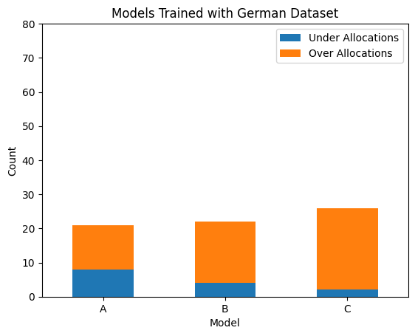
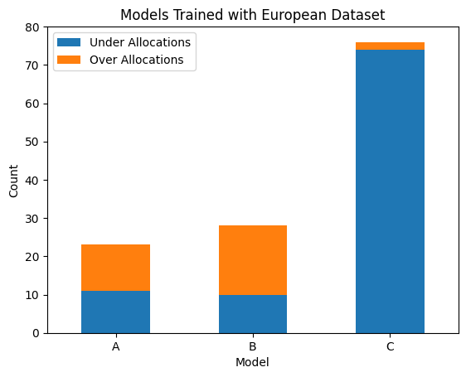
A: Optimized Classifier
B: Regressor chosen with Allocation scores
C: Regressor chosen with AIC and BIC scores
Results

Slide 31
Transfer Learning
European → German

Slide 32
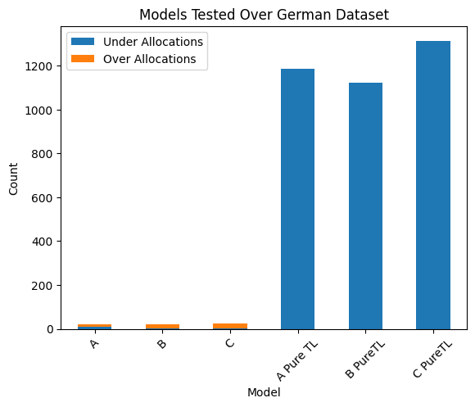
Compare TL Techniques
Pure transfer learning
Domain adaptation data split
Train results
Test results
Compare domain adaptation performance in target domain with native model from target domain
A: Optimized Classifier
B: Regressor chosen with Allocation scores (Q075_pb0) C: Regressor chosen with AIC and BIC scores (Q025_pb0)

Slide 33
Compare TL Techniques
European 80%
German 80%
Native Model
Pure transfer learning
Domain adaptation data split
Train results
Test results
Compare domain adaptation performance in target domain with native model from target domain
European 20%
German 20%
Domain Adapted Model

Slide 34
Compare TL Techniques
Pure transfer learning
Domain adaptation data split
Train results
Test results
Compare domain adaptation performance in target domain with native model from target domain
Test set for domain adapted model
Test set for native model

Slide 35
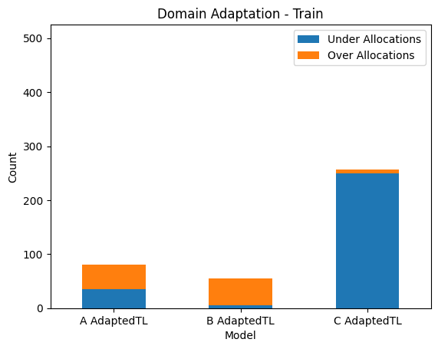
Compare TL Techniques
Pure transfer learning
Domain adaptation data split
Train results
Test results
Compare domain adaptation performance in target domain with native model from target domain
A: Optimized Classifier
B: Regressor chosen with Allocation scores (Q075_pb0) C: Regressor chosen with AIC and BIC scores (Q025_pb0)

Slide 36
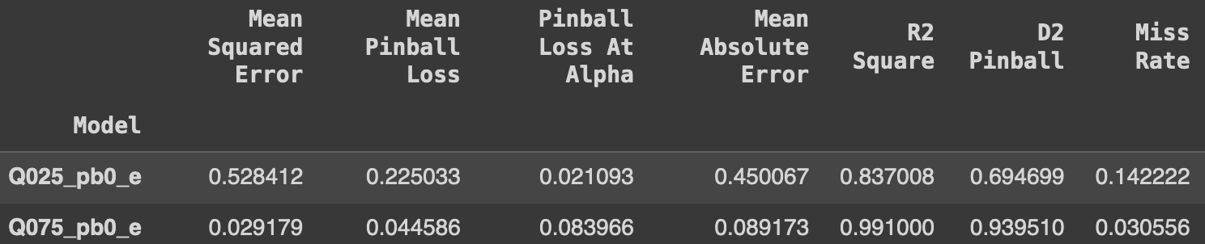
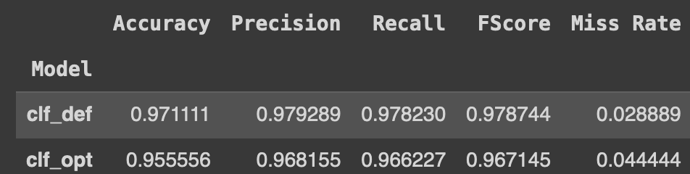
Compare TL Techniques
Model | Cross Validation
Adapted Optimized Classifier | 0.933333
Adapted Best Allocation Score | 0.973149
Adapted Best AIC/BIC Score | 0.808536
Pure transfer learning
Domain adaptation data split
Train results
Test results
Compare domain adaptation performance in target domain with native model from target domain
A: Optimized Classifier
B: Regressor chosen with Allocation scores (Q075_pb0) C: Regressor chosen with AIC and BIC scores (Q025_pb0)

Slide 37
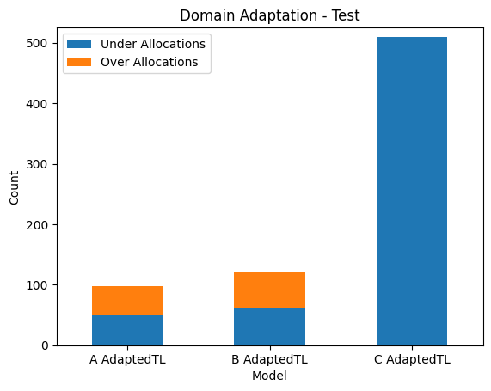
Compare TL Techniques
Best AIC/BIC score
Pure transfer learning
Domain adaptation data split
Train results
Test results
Compare domain adaptation performance in target domain with native model from target domain
Best Allocation score
A: Optimized Classifier
B: Regressor chosen with Allocation scores (Q075_pb0) C: Regressor chosen with AIC and BIC scores (Q025_pb0)

Slide 38
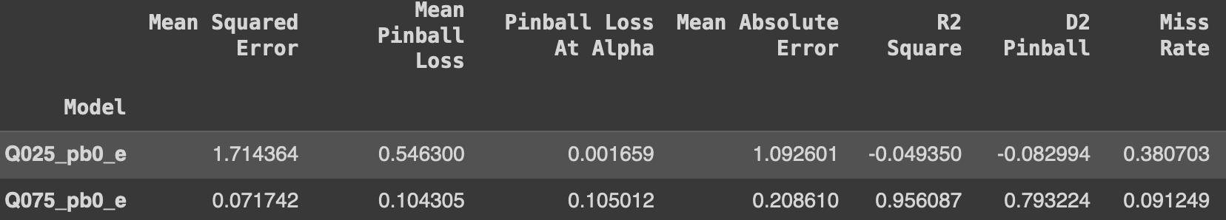
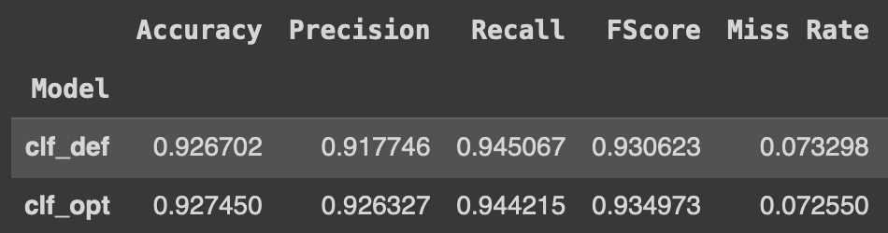
Compare TL Techniques
Model | Cross Validation
Adapted Optimized Classifier | 0.933333
Adapted Best Allocation Score | 0.973149
Adapted Best AIC/BIC Score | 0.808536
Pure transfer learning
Domain adaptation data split
Train results
Test results
Compare domain adaptation performance in target domain with native model from target domain
A: Optimized Classifier
B: Regressor chosen with Allocation scores (Q075_pb0) C: Regressor chosen with AIC and BIC scores (Q025_pb0)

Slide 39
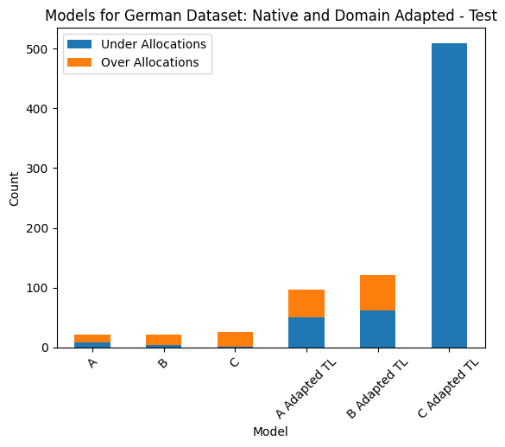
Compare TL Techniques
Pure transfer learning
Domain adaptation data split
Train results
Test results
Compare domain adaptation performance in target domain with native model from target domain
A: Optimized Classifier
B: Regressor chosen with Allocation scores (Q075_pb0) C: Regressor chosen with AIC and BIC scores (Q025_pb0)

Slide 40
Final Points
Default classifier performed very well and comparable to optimized classifier.
Model selected based on statistical tests had weakest cross validation results and did not perform well over test sets compared to other models.
Pure transfer learning does not work well.
Domain adaptation yielded promising results; potential for addition of other countries with just a “few” samples.
Statistical tests are insufficient as a measure of generalization even in our simple implementation of transfer learning.

Slide 41

Thanks!

